Slide 1
Market Basket Analysis
Introduction.
Dataset.
Software used
Approach
Visualizations
Observations
Conclusions

Slide 2
Introduction
Market Basket Analysis is one of the key techniques used by large retailers to uncover associations between items.
We have applied Apriori Algorithm Apriori function to extract frequent itemsets for association rule mining.
Objective of this project is we have to find correlations between the different items in the store. so that we can know if a customer is buying apple, banana and mango. what is the next item, The customer would be interested in buying from the store.
The apriori algorithm has been designed to operate on databases containing transactions, such as purchases by customers of a store. An itemset is considered as "frequent" if it meets a user-specified support threshold.
For instance, if the support threshold is set to 0.5 (50%), a frequent itemset is defined as a set of items that occur together in at least 50% of all transactions in the database.

Slide 3
Dataset
We have used Market_Basket_Optimisation dataset in this project.
This is mall dataset with 7500 transactions of different customers buying different items from the store.
Including many items like.
Turkey.
Chicken.
Water.
Butter.
Chutney etc.

Slide 4
Apriori Algorithm
A key concept in Apriori algorithm is the anti-monotonicity of the support measure. It assumes that:
All subsets of a frequent itemset must be frequent.
Similarly, for any infrequent itemset, all its supersets must be infrequent too.
Steps included are:-
Create a frequency table of all the items that occur in all the transactions.
We know that only those elements are significant for which the support is greater than or equal to the threshold support.
The next step is to make all the possible pairs of the significant items keeping in mind that the order doesn’t matter, i.e., AB is same as BA.
We will now count the occurrences of each pair in all the transactions.
Again only those itemsets are significant which cross the support threshold
Now let’s say we would like to look for a set of three items that are purchased together. We will use the itemsets found in step 5 and create a set of 3 items.

Slide 5
Approach
Collected dataset from kaggle
Applied EDT(Exploratory Data Analysis) For Removing unnecessary variable and data.
Plotted different visualization to finding correlations between the different items in the store.
Data pre-processing .
Applied Apriori Algorithm function to extract frequent itemsets for association rule mining.

Slide 6
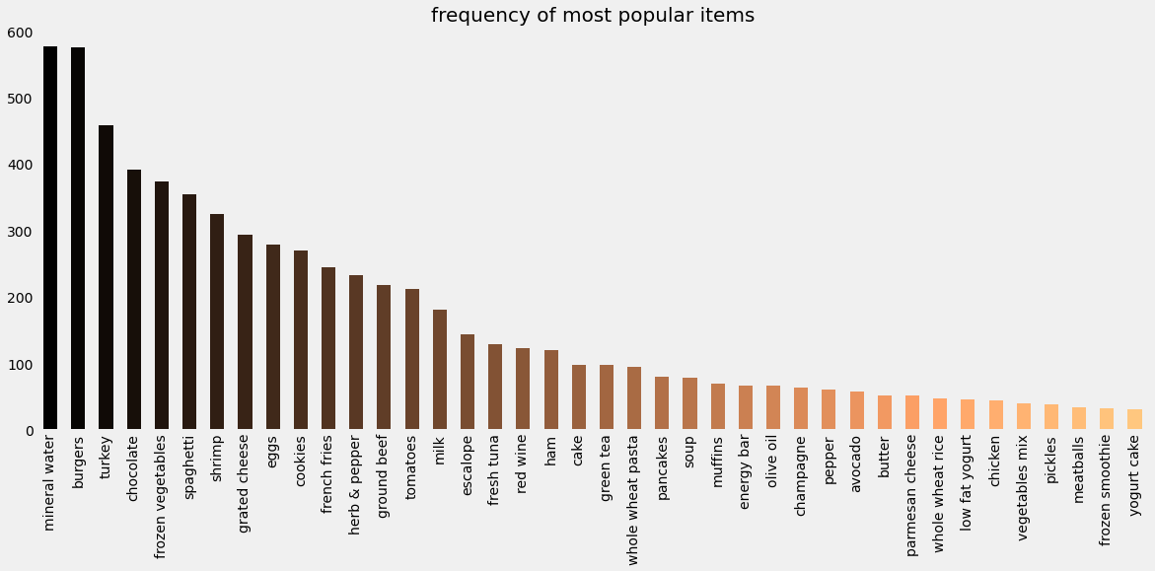
Visualiztion
Using Matplotlib plotted
Frequency of most popular items

Slide 7
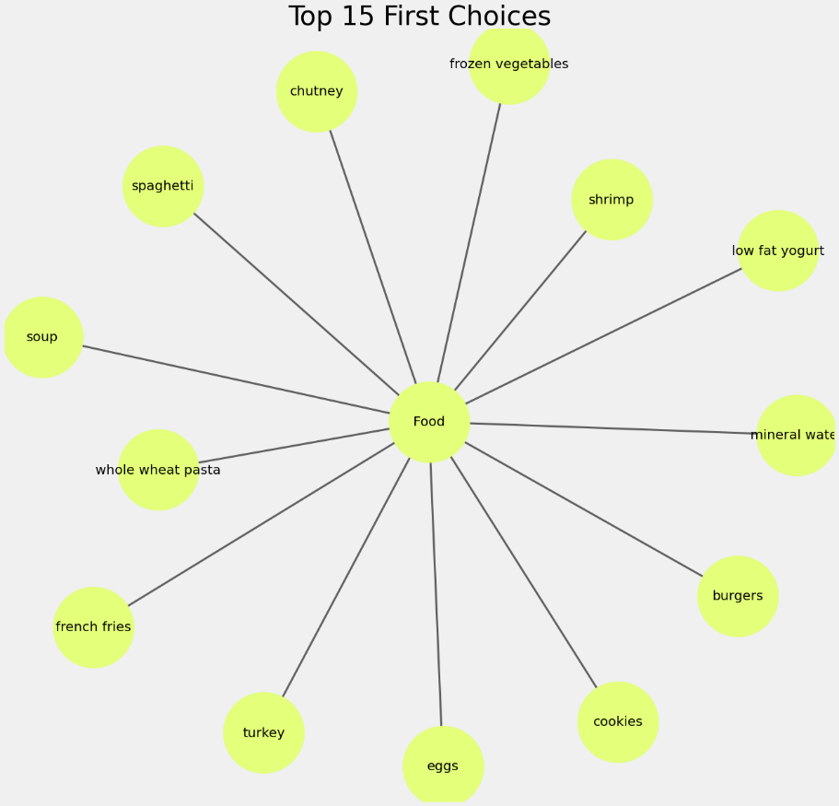
Plloted graph through which we can find top 15 first choices of people.

Slide 8
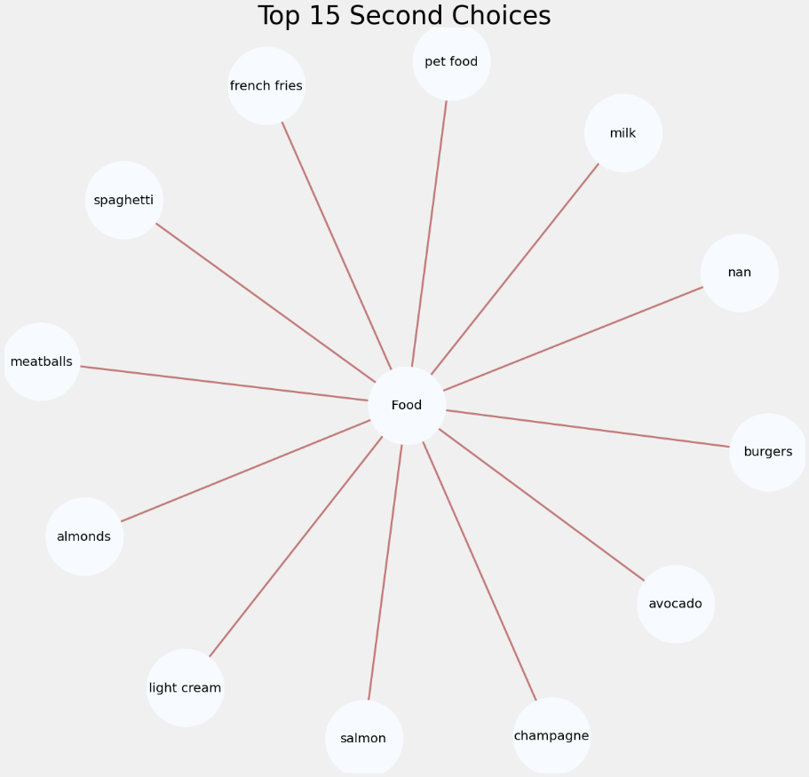
Plloted graph through which we can find top second 15 choices of people.

Slide 9
Observation

